Slide 1
Model training
Machine Learning with Python

Slide 2
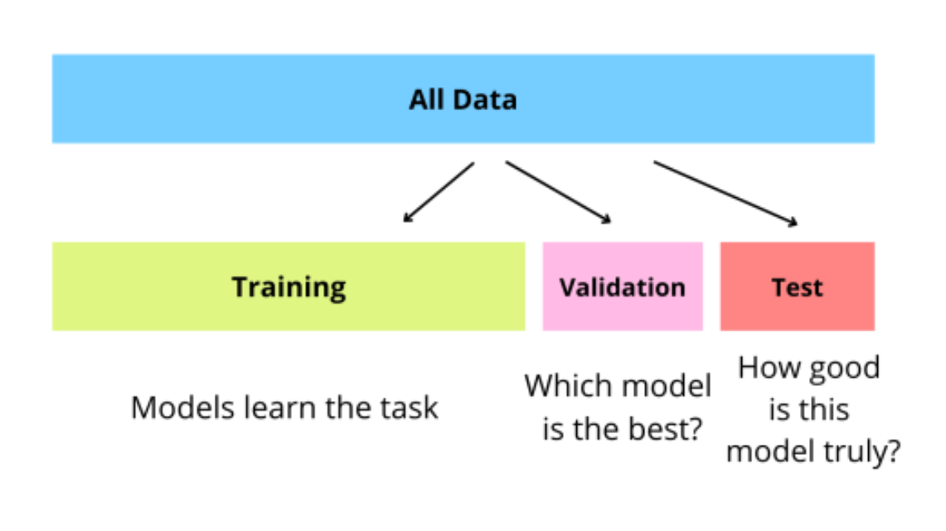

Slide 3
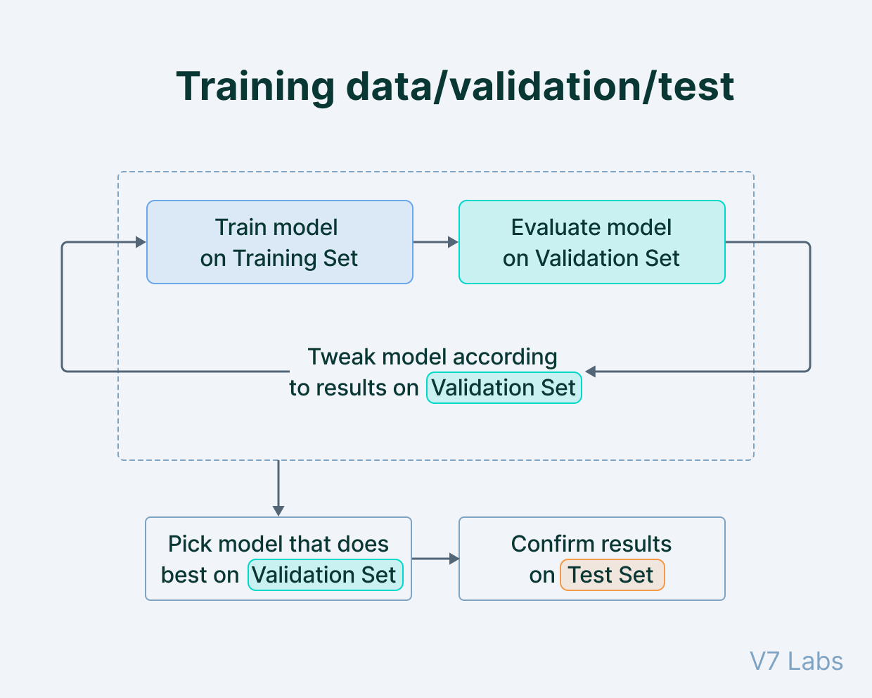

Slide 4
